Slide 1
MESSAGE PASSING
Chapter-2

Slide 2
OVERVIEW
Introduction
Features of Message Passing System
Issues in IPC
Synchronization
Buffering
Multi datagram Messages
Encoding and Decoding of Message data
Process Addressing
Failure Handling
Group Communication

Slide 3
INTRODUCTION
In DS, processes executing on different computers often need to communicate with each other to achieve common goal
Therefore, DOS needs to provides IPC (interprocess communication) mechanism
Interprocess communication requires information sharing
Two basic methods for information sharing:
1. Original Sharing, or shared-data approach
2. Copy sharing, or message-passing approach

Slide 4

INTRODUCTION(CONT...)
Shared-data approach: Information to be shared is placed in a common memory area that is accessible to all the processes involved in IPC
Message-passing approach:
Information to be shared is
physically copied from the
sender process's address space
to the address space of all the
receiver processes
Message Passing is the basic IPC mechanism in DS.

Slide 5
Message Passing
How do processes refer to each other?
S
R
  Can a message be sent to a group?
R₁
“Mailbox”
R₂
S
...
R_{m}
Notes:
How are messages addressed?
— How does a sender specify the desired receiver(s)?
— How does a receiver specify the desired sender(s)?
Two flavors:
“Direct” or “Explicit” naming — A process is explicitly specified.
“Indirect” or “Implicit” naming — An intermediary is specified.
— Multicast v. unicast.
— The port model is in TCP/IP and hence tends to dominate.
In the case of indirect naming, we often introduce another primitive, here called select, that allows a receiver to learn the identity of a sender. (And to notify a process when a message has arrived.) More later...
— Mailboxs/ports are more versatile as they allow for more dynamic forms of interaction but are more expensive to implement.
What does the user want to use? What does the OS want to provide?

Slide 6
INTRODUCTION(CONT...)
Message-passing system: Subsystem of a distributed system
Provides a set of message-based IPC protocols and does so by shielding the details of complex network protocols & multiple heterogeneous platforms from programmers
Enables processes to communicate by exchanging messages and allows programs to be written by using simple communication primitives, such as send and receive

Slide 7
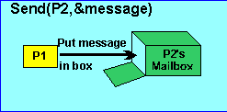
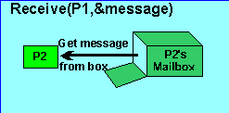
INTRODUCTION(CONT...)
Message-passing system

Slide 8
FEATURES OF A GOOD MESSAGE PASSING SYSTEM
1. Simplicity:
Should be simple and easy to use
It must be straightforward to construct new applications and to communicate with existing ones
Allows programmer to designate the different modules of a distributed application & to send and receive messages between them without the need to worry about the system and/or network aspects
Clean & simple semantics of the IPC protocols of a message-passing system make it easier to build distributed application

Slide 9
FEATURES OF A GOOD MESSAGE PASSING SYSTEM
2. Uniform Semantics:
In ds, a message-passing system may be used for the following two types
of interprocess communication:
1. Local communication: communicating processes are on the same node
2. Remote communication: communicating processes are on different nodes
Issue in the design of a message-passing system: Semantics of remote
communications should be as close as possible to those of local
communications
This is an important requirement for ensuring that the message-passing system is easy to use

Slide 10
FEATURES OF A GOOD MESSAGE PASSING SYSTEM
3. Efficiency:
A critical issue for a message-passing system
If it is not efficient, interprocess communication may become so expensive
Application designer will try to avoid its use, so the developed application program would be distorted
An IPC protocol can be made efficient by reducing the number of message exchanges

Slide 11
FEATURES OF A GOOD MESSAGE PASSING SYSTEM
Some optimization normally adopted for efficiency include the following:
1. Avoiding costs of establishing & terminating connections between the
same pair of processes for each & every message exchange
2. Minimizing costs of maintaining the connections
3. Piggybacking of acknowledgement of previous messages with the next
message during a connection between a sender & a receiver that involves
several message exchanges

Slide 12
FEATURES OF A GOOD MESSAGE PASSING SYSTEM
4. Reliability:
DS are prone to different catastrophic events such as node crashes or communication link failures
Such events may interrupt a communication that was in progress,
resulting in the loss of a message
A reliable IPC protocol can cope with failure problems & guarantees the delivery of a message
Handling of lost messages usually involves acknowledgments &
retransmission on the basis of timeouts

Slide 13
FEATURES OF A GOOD MESSAGE PASSING SYSTEM
Another issue is duplicate messages
Duplicate messages may be sent in the event of failures or because of timeouts
Reliable IPC protocol is capable of detecting & handling duplicates
It involves generating & assigning appropriate sequence numbers to messages

Slide 14
FEATURES OF A GOOD MESSAGE PASSING SYSTEM
5. Correctness:
It is a feature related to IPC protocols for group communication
A message-passing system often has IPC protocols for group
communication
Issues:
  Atomicity:
  Ordered Delivery
  Survivability

Slide 15
FEATURES OF A GOOD MESSAGE PASSING SYSTEM
6. Flexibility:
Not all applications require the same degree of reliability and
correctness of the IPC protocols. For eg; adaptive routing
A broadcast protocol could be used
Similarly, many applications do not require atomicity or
ordered delivery of messages
For eg; a client may multicast a request a request message
to a group of servers and offer the job to the first server that
replies

Slide 16
FEATURES OF A GOOD MESSAGE PASSING SYSTEM
IPC protocols of a message-passing system must be flexible
enough to cater to the various needs of different applications
IPC primitives should be such that the users have the flexibility to choose and specify the types and reliability and correctness requirements of their applications
Must also have the flexibility to permit any kind of control flow between the cooperating processes, including synchronous and asynchronous send/receive

Slide 17
FEATURES OF A GOOD MESSAGE PASSING SYSTEM
7. Security:
A god message-passing system must also be capable of providing a secure end-to-end communication
A message in transit on the network should not be accessible to any user other than sender and receiver
Steps necessary for secure communication:
Authentication of the receiver(s) of a message by the sender
Authentication of the sender of a message by its receiver(s)
Encryption of a message before sending it over the network

Slide 18
ISSUES IN IPC BY MESSAGE-PASSING
Message: Fixed-length header & a variable-size Collection of typed data objects
A message header consists of the following elements-
Address-Uniquely identify the sending and receiving process
1. Sending process address
2. Receiving process address
Sequence Number-message identifier(ID)
  For identifying lost messages and duplicate messages
  Structural information-2 parts
    Type-specifies the data is included within the message or the message only contains a pointer to the data
    Length-Specifies length of the variable-size message data

Slide 19
MESSAGE STRUCTURE
Actual Data or pointer to the data | Structural Information |  | Sequence number or message ID | Addresses
 | Number of bytes/elements | Types |  | Receiving process address | Sending process address

Slide 20
ISSUES IN THE DESIGN OF IPC
Who is the sender?
Who is the receiver?
Is there one receiver or many receivers?
Is the message guaranteed to have been accepted by its receiver(s)?
Does the sender need to wait for a reply?
What should be done if a failure occurs during the course of communication

Slide 21
ISSUES IN THE DESIGN OF IPC
What could be done if the receiver is not ready to accept the message?
How to choose the order for selecting outstanding messages?

Slide 22
SYNCHRONIZATION
There are two semantics used
Blocking primitive - sending process is blocked until it receives reply /ack
Non-blocking primitive - sending process is allowed to proceed with its execution as soon as transferred
When both the send and receive primitives of a communication between two processes use blocking semantics, the communication is said to be Synchronous, otherwise it is asynchronous

Slide 23
SYNCHRONIZATION
Blocking communication:
A primitive is said to have blocking semantics if its invocation blocks the execution of its invoker
Blocking send primitives: After execution of send statement the sending process is blocked until it receives an ack from the receiver
Blocking receive primitives: after execution of receive statement the receiving process is blocked until it receive a message

Slide 24
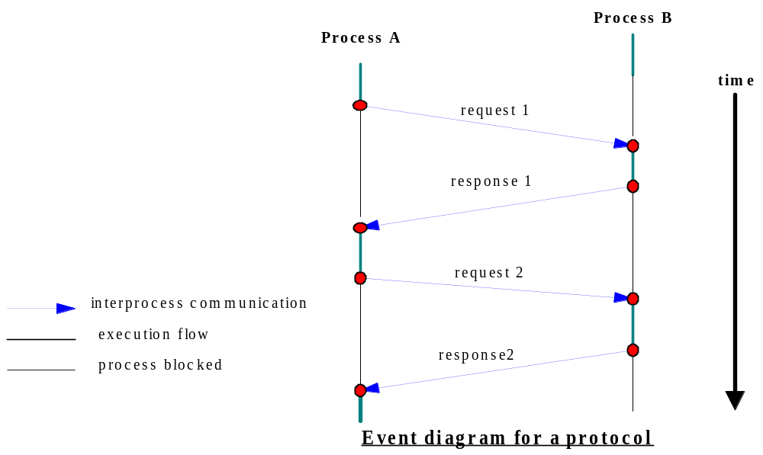
EVENT DIAGRAM
Synchronous send and receive

Slide 25
SYNCHRONIZATION
NON-BLOCKING COMMUNICATION:
A PRIMITIVE IS SAID TO HAVE NON BLOCKING SEMANTICS IF ITS INVOCATION DOES NOT BLOCK THE EXECUTION OF ITS INVOKER
NON BLOCKING SEND PRIMITIVES: AFTER EXECUTION OF SEND STATEMENT, THE SENDING PROCESS IS ALLOWED TO PROCEED WITH ITS EXECUTION AS SOON AS THE MESSAGE IS COPIED TO THE BUFFER.
NON BLOCKING RECEIVE PRIMITIVES: THE RECEIVE PROCESS PROCEEDS ITS EXECUTION OF RECEIVE STATEMENT, WHICH RETURNS CONTROL IMMEDIATELY JUST AFTER TELLING THE KERNEL WHERE THE MESSAGE BUFFER IS

Slide 26
Semantics of Message Passing
send(receiver, message)
Synchronization
Blocking
Non-blocking
Send message to receiver
Wait until message is accepted.
Send message to receiver
Explicit
(single)
Implicit
(group)
Broadcast message to all receivers. Wait until message is accepted by all
Broadcast message to all receivers
Notes:
The space of possibilities for sending a message…
— Naming and synchronization semantics are orthogonal issues.
Note that implicit naming doesn’t necessarily imply that you are sending to multiple receivers.
— It just means that you are sending to an intermediate object.
How to think about these choices?
— What’s easy/hard for the OS to implement?
— What are programmers likely to want/use?
Example: Implicit naming with blocking is hard to implement as it requires coordination between all receivers.
OS want to provide the simplest, highest performance primitive that affords the user/programmer the most flexibility.
— What’s the most “universal” primitive?
— (Is there an analog of a binary semaphore for message passing?)

Slide 27
Semantics of Message Passing
receive(sender, message)
Synchronization
Blocking
Non-blocking
Wait for a message from sender
If there is a message from sender then receive it, else continue
Explicit
(single)
Implicit
(group)
Wait for a message from any sender
If there is a message from any sender then receive it, else continue
Notes:
The space of possibilities for receiving a message…
Note that non-blocking receive is of dubious use.
Mention that blocking send/receive are the most common forms of the primitives.

Slide 28
sender
receiver
BLOCKING
send
send
NO
COMPUTATION
ACK
sender
receiver
send
NON-BLOCKING
ACK (?)
Notes:
[pg 34] (cont.)

Slide 29
Synchronization in Non-Blocking Communication
How the receiving process knows that the message has arrived in massage buffer in case of non blocking receive
- two methods
1. Polling (checking the buffer status)
A test primitive: to check the buffer status
Receiver uses this to periodically poll the kernel to check if the
message is already available in the buffer
2. Interrupt
when the message has been filled in the buffer and is ready for use and is ready for use by the receiver
s/w interrupt is used to notify the receiving process

Slide 30
BUFFERING
  Null buffer / No buffer - no place to temporarily store the message
  Single-message buffer - a buffer having a capacity to store a single message is used on the receiver’s node
  Unbounded-Capacity Buffer – stack to hold buffered messages
    Practically impossible to implement, thus Finite-Bound Buffer is used often.

Slide 31
NULL BUFFER
No place to temporarily store the message
Following implementation strategies are used-
1.Message remains in the sender process address space
Execution of send is delayed until the receiver executes the corresponding receive
When receiver executes receive , an acknowledgement is sent to the senders kernel
On receiving the acknowledgement message ,the sender is unblocked, causing the send to be executed once again
2.The message is simply discarded and timeout mechanism is used to resend the message after timeout period

Slide 32
NULL BUFFER
After executing send ,the sender process waits for an acknowledgement from the receiver
If no acknowledgement is received within the timeout period, it assumes that its message was discarded and tries again hoping that this time the receiver has already executed receive.
Drawbacks:
Not suitable for synchronous communication between two processes

Slide 33
MESSAGE TRANSFER IN SYNCHRONOUS SEND WITH NO BUFFERING AND SINGLE BUFFERING
Message
Sending Process
Receiving Process
Message
Node Boundary

Slide 34
SINGLE MESSAGE BUFFER
Buffer having capacity to store a single message is used on the receiver’s node
The main idea is to keep the message ready for use at the location of the receiver.
The message buffer is located in the kernel’s address space or in the receiver process’s address space
The logical path of message transfer involves two copy operations.

Slide 35
UNBOUNDED CAPACITY BUFFER
In the asynchronous mode of communication, since a sender does not wait for the receiver to be ready, there may be several pending message that have not yet been accepted by the receiver
Therefore, an unbounded capacity message buffer
That can store all un received message is needed to support asynchronous communication with assurance that all the message sent to the receiver will be delivered.

Slide 36
FINITE-BOUND(MULTIPLE MESSAGE) BUFFER
Also known as multiple message buffers
Problem with buffer having a finite bound-
  -Buffer Overflow
  Ways to dealt with a buffer overflow problem
  1.Unsuccessful Communication
  Message transfers simply fail whenever there is no more buffer space
  The send normally returns an error message to the sending process, indicating that the message could not be delivered to the receiver because the buffer ifs full.

Slide 37
FINITE-BOUND(MULTIPLE MESSAGE) BUFFER
  Drawback:
  This method makes message passing less reliable
2.Flow controlled communication
Sender is blocked until receiver accepts some messages
Introduces a Synchronization between the sender and the receiver
Drawback-
Unexpected deadlock
More complex to design and use

Slide 38
FINITE-BOUND(MULTIPLE MESSAGE) BUFFER
Message1
Message
Message2
Message3
Sending Process
Receiving Process
Message n
Message Transfer in asynchronous send with multiple message buffering strategy

Slide 39
MULTIDATAGRAM MESSAGES
Maximum Transfer Unit(MTU):Size of data that can be transmitted
at a time
Messages greater than the MTU are broken into chunks or datagrams
and transmitted independently
Message
Datagram 1
Datagram 1
Datagram 1

Slide 40
MULTIDATAGRAM MESSAGES
Single-datagram messages: Messages smaller than the MTU of the
network can be sent in a single packet
Multi-datagram Messages: Messages larger than the MTU of the
network have to be fragmented and sent in multiple packets
Different packets of a multidatagram message bear a sequential
relationship to one another
The disassemebling of a multidatagram message into multiple
packets on the sender side & reassembling of the packets on the
receiver side is usually the responsibility of the message-passing
system

Slide 41
ENCODING & DECODING OF MESSAGE DATA
Structure of the program object should be preserved while transmission from address space of sending process to receiving space
Not possible in Heterogeneous system (different architecture)
Difficult in Homogeneous system because of
  Absolute pointer values loses its meaning
  Different program objects occupy varying amount of storage space
Therefore, program objects are first converted to a stream form and placed into a message buffer
This conversion process takes place on sender side & is know as encoding of message data
The process of reconstruction of program objects from message data on the receiver side is know as decoding of message data

Slide 42
ENCODING & DECODING OF MESSAGE DATA
Representations for encoding and decoding:
Tagged representation : program object along with its value is encoded in the message
Self describing nature of the coded data format
  ASN.1
  Mac DOS
Untagged representation: message data contains only program objects
No information is included in the message data to specify the type of each program object
Receiving process must have a prior knowledge of how to decode the received data
Sun XDR
Courier

Slide 43
PROCESS ADDRESSING
How does the sender know whom to send the message?
Conversely, has the receiver identified the correct sender?
For appropriate message-based communication, all processes need to be addressed or named.
It is important for both the sender & the receiver to know each other so that the receiving process can accept the message from the correct sender
A flexible message-passing system supports two process addressing techniques

Slide 44
PROCESS ADDRESSING
Explicit Addressing: The primitive directly names the process with which it communicates
send(process_id, message)
Receive(process_id, message)
Implicit Addressing: Does not explicitly name a process for communication
(c) send_any(service_id, message): sender names a service instead
of a process
(d) receive_any(process_id, message):Receive a message from any
process & return the process identifier(“process_id”) of the
process from which the message was received

Slide 45
PROCESS ADDRESSING
Methods for process addressing:
Two-Level Addressing
Combination of machine_id and local_id is used to
identify a process
Syntax: machine_id@local_id
Features: No global coordination is needed to generate
systemwide unique process identifiers
Drawback: No process migratioon

Slide 46
PROCESS ADDRESSING
Three-Level Addressing
Process can be identified by a combination of three fields: machine_id, local_id, and machine_id
Syntax: machine_id@local_id@machine_id
Drawback:
Overload of locating a process
Difficult to locate a process if an intermediate node is down

Slide 47
FAILURE HANDLING
Distributed system is prone to partial failures such as a node crash or a communication link failure
Problems due to the failure:
Loss of request message
Loss of response message
Unsuccessful execution of the request
Solution:
Retransmission of message after timeouts

Slide 48
FAILURE HANDLING
A reliable IPC protocol is designed based on the retransmission of message after a timeout, if the acknowledgement is not received
Based on the number of messages required to complete the message transfer, the IPC protocols are classified as:
4-Message reliable IPC protocol
3-Message reliable IPC protocol
2-Message reliable IPC protocol

Slide 49
FAILURE HANDLING
Client
Server
Request
Request
Acknowledgement
Reply
Reply
Acknowledgement
Acknowledgement
1. 4-message reliable IPC protocol
2. 3-message reliable IPC protocol

Slide 50
3. 2-Message reliable IPC protocol
The protocol is said to obey at-least-once semantics, it ensures that at least one execution of the receiver’s operation has been performed

Slide 51
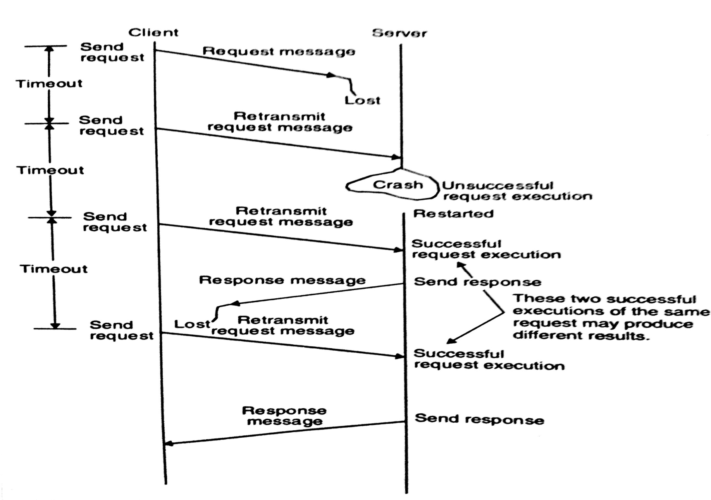
EXAMPLE OF FAILURE HANDLING DURING COMMUNICATION BETWEEN TWO PROCESSES

Slide 52
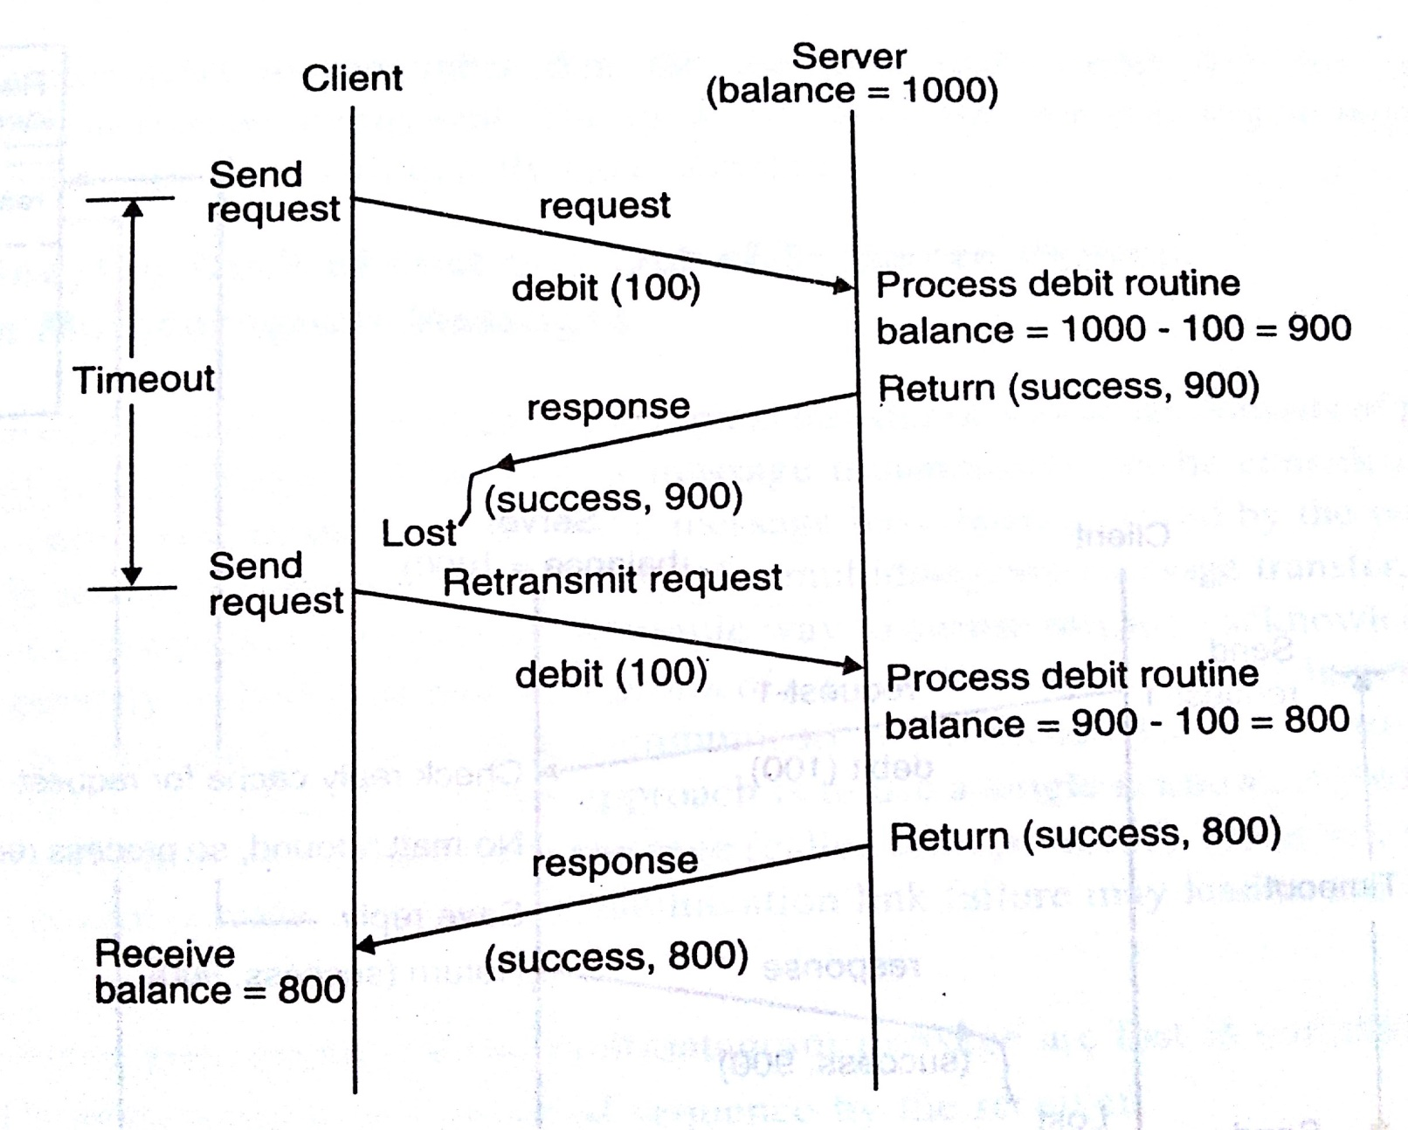
IDEMPOTENCY & HANDLING OF DUPLICATE REQUEST MESSAGES

Slide 53
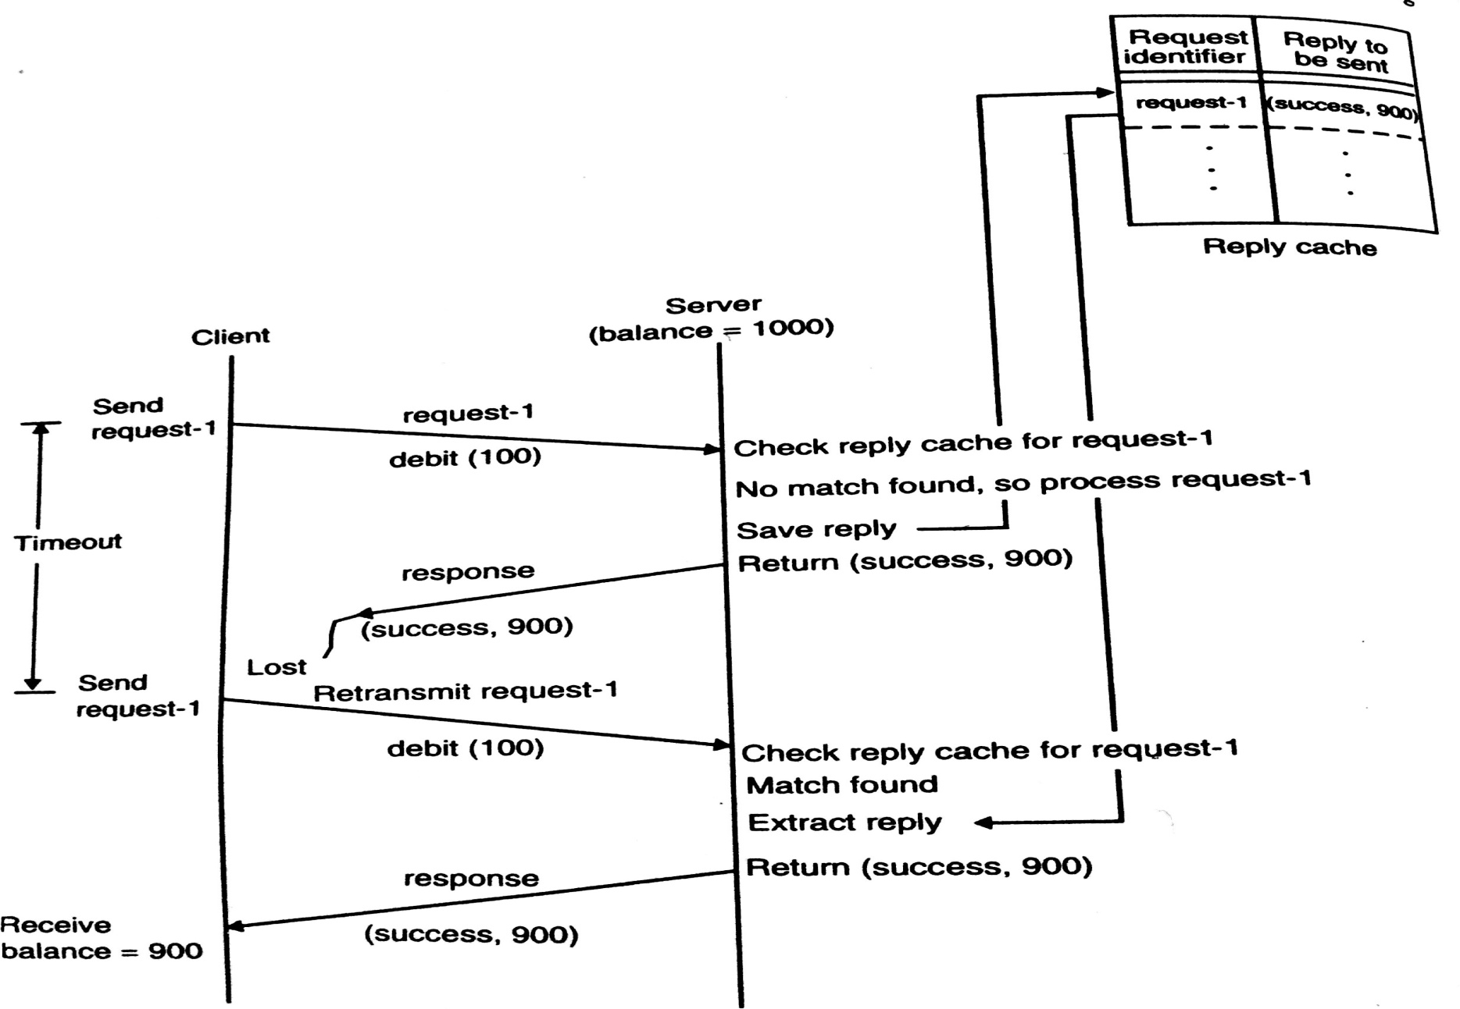
IDEMPOTENCY & HANDLING OF DUPLICATE REQUEST MESSAGES

Slide 54
KEEPING TRACK OF LOST & OUT-OF-SEQUENCE PACKETS IN MULTIDATAGRAM MESSAGES
In Multidatagram messages, the logical transfer of a message consists of physical transfer of several packets
Therefore, a message transmission can be considered to be complete only when all the packets are received by receiver
For successful completion of message transfer, reliable delivery of every packet is important
Acknowledge each packet separately(stop-and-wait protocol)
But it leads to a communication overhead

Slide 55
KEEPING TRACK OF LOST & OUT-OF-SEQUENCE PACKETS IN MULTIDATAGRAM MESSAGES
To use a single acknowledgement packet for all the packets (called blast protocol)
In this approach if node crashes or communication link fails, may lead to the following problems:
1. One or more packets of the multidatagram
message are lost in communication
2. The packets are received out of sequence by
the receiver
Solution: Use a bitmap to identify the packets of a message

Slide 56
KEEPING TRACK OF LOST & OUT-OF-SEQUENCE PACKETS IN MULTIDATAGRAM MESSAGES
In this mechanism, the header part of each packet consists of two extra fields
1. Specifies total number of packets in the multidatagram message
2. Bitmap field, specifies the position of this packet in the complete message

Slide 57
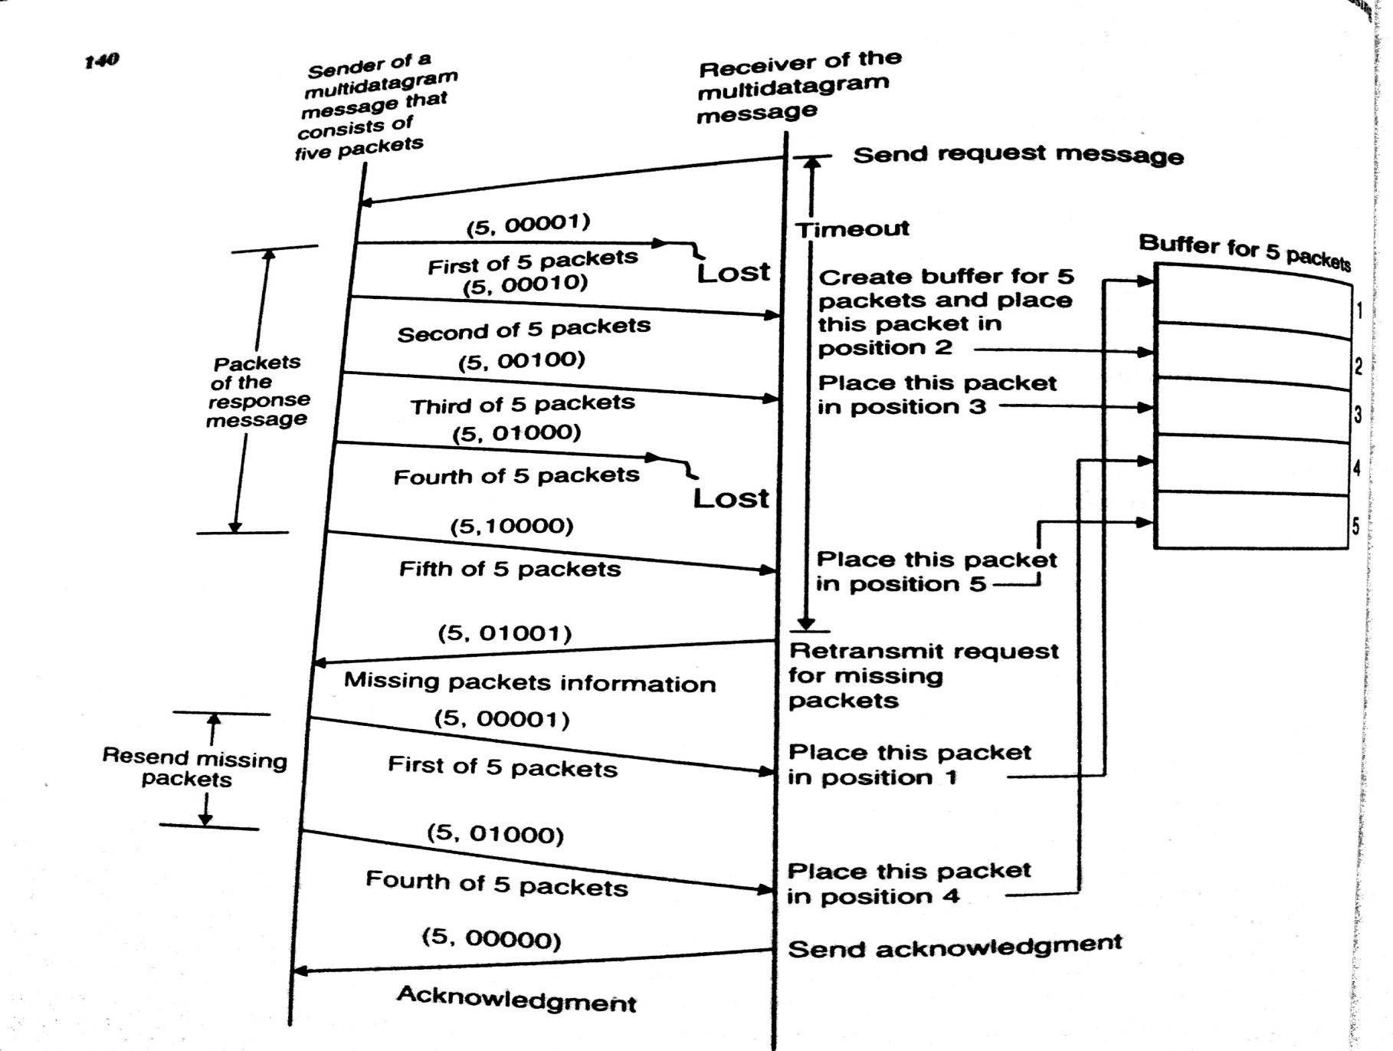
EXAMPLE

Slide 58
GROUP COMMUNICATION
Types of group communication-Depending on single or multiple senders and receivers
1.One to Many
2.Many to One
3.Many to Many

Slide 59
GROUP COMMUNICATION
1.One to Many (multicast communication)
A special case of multicast is broadcast communication
Very useful for practical applications
E.g. server manager
Group Management
Receiver processes of a message form a group.
Two types of group-
1.Closed
2.Open

Slide 60
GROUP MANAGEMENT
1.Closed:
Only the members of the group can send a message to the group
e.g. group of processes working on a common problem
2.Open:
Any process in the system can send a message to the group as a whole.
e.g. group of replicated servers
Whether to use closed group or an open group is application dependent.

Slide 61
GROUP MANAGEMENT
A flexible message passing system with group communication facility should support both types of groups
A message passing system with group communication facility provides the flexibility-
To create and delete group dynamically
To allow a process to join or leave a group of replicated servers
Centralized group server process is used for managing the groups
Problem-Poor reliability and Poor scalability
Solution: Replication of the group server (but it leads to extra overhead)

Slide 62
GROUP COMMUNICATION
Group Addressing
Two level naming scheme is used for group addressing
High level group name is in ASCII string and is independent of the location information of the processes in a group
Low level group name depends to a large extent on underlying hardware.

Slide 63
GROUP COMMUNICATION
Message Delivery to Receiver Process

Slide 64
Buffered and Unbuffered Multicast
Buffered-The message is buffered for the receiving processes
Unbuffered-the message is not buffered for the receiving process
Multicasting is an asynchronous communication mechanism.
Multicast send cannot be synchronous –
  It is unrealistic to expect a sending process to wait until all the receiving processes are ready to receive the multicast message
  The sending process may not be aware of all the receiving processes that belong to the multicast group

Slide 65
SEND TO ALL AND BULLETIN BOARD SEMANTICS
Two types of semantics for many to one communication
  Send-to-all: message is sent to each process of multicast group and it is buffered until it is accepted by the process.
  Bulletin-board semantics: message to be multicast is addressed to a channel
Bulletin-board semantics is more flexible than send-all semantics because
1.The relevance of a message to a particular receiver may depend on the receivers state
2.Messages not accepted within a certain time after transmission may no longer be useful

Slide 66
FLEXIBLE RELIABILITY IN MULTICAST COMMUNICATION
Different applications require different degrees of reliability.
Degree of reliability in multicast comm. is expressed as
  0- reliable: no response is expected by the sender from any of the receiver
  1- reliable :sender expects a response from any of the receiver e;g first server that responds
  m-out-of-n- reliable: a multicast group consist of n recievers and the sender expect a response from m. i;e majority consensus used for consistency control of replicated info.
  all-reliable : expect the response from all receiver
  E.g. updating the replica of a file

Slide 67
Atomic Multicast
Has an all or nothing property
  Send-to-all semantics and all-reliable
  Simple emulation:
    A repetition of one-to-on communication with acknowledgment
  What if a receiver fails
    Time-out retransmission
    What if a sender fails before all receivers receive a message
    All receivers forward the message to the same group.
    A receiver discard the 2nd or the following messages.

Slide 68
MANY TO MANY
Multiple senders send messages to multiple receivers
Issue-Ordered message delivery
Ordered message delivery requires message sequencing
Commonly used semantics for ordered delivery of multicast messages are-
  Absolute ordering
  Consistent
  Causal

Slide 69
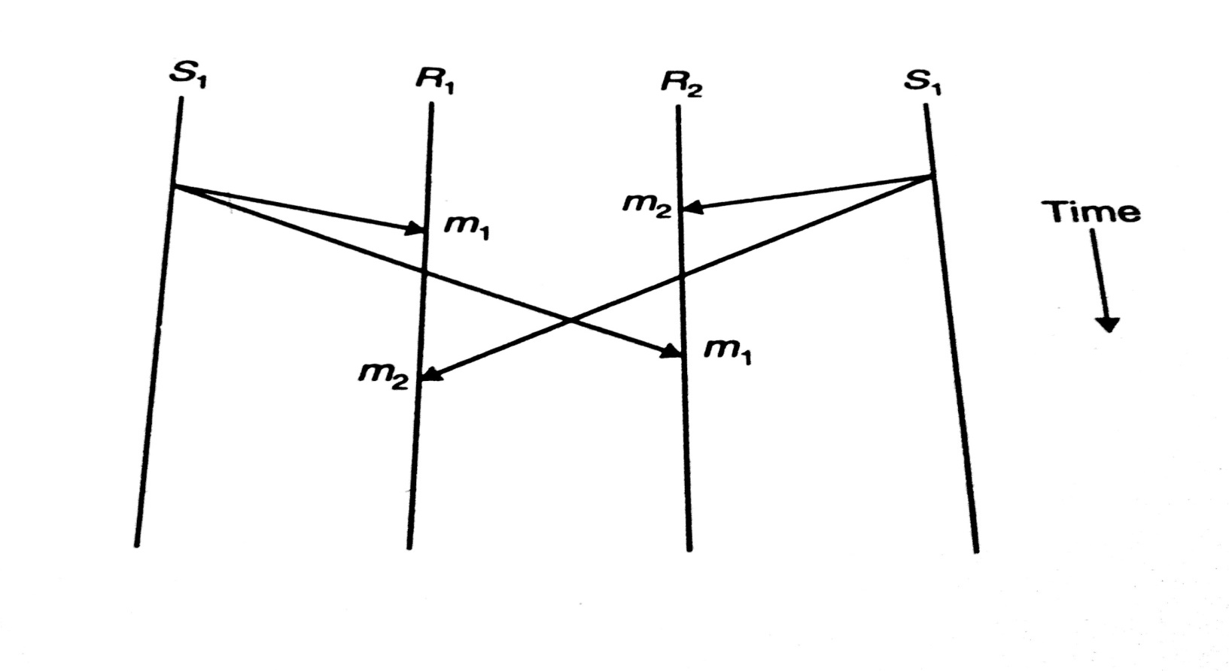
NO ORDERING
No Ordering: a message sent from a sender may arrive at a receiver’s destination before the arrival of a message from another sender, but this order may be reversed at another’s receiver destination

Slide 70
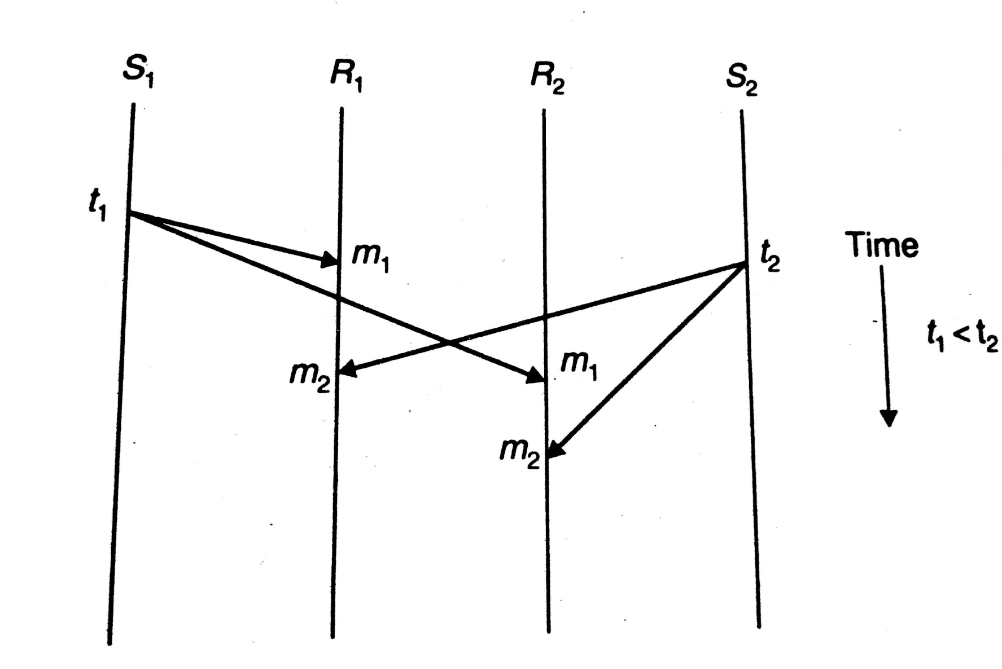
ABSOLUTE ORDERING
All messages are delivered to all receiver processes in in the exact order in which they were sent
Method to implement: Use global timestamps as message identifier

Slide 71
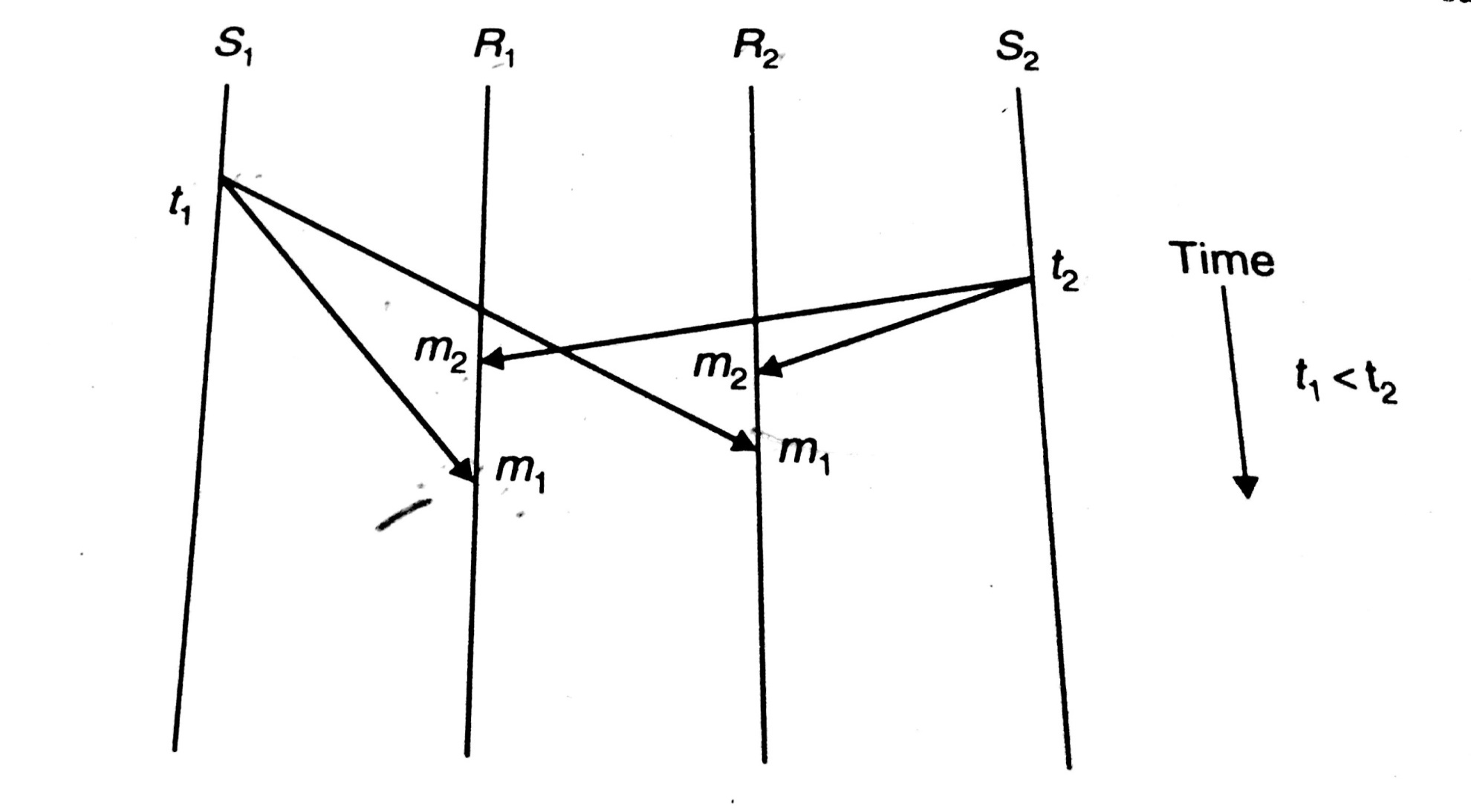
CONSISTENT ORDERING
All messages are delivered to all receiver processes in the same order
Order may be different from the order in which messages were sent

Slide 72
CAUSAL ORDERING
This semantic ensures that if the event of sending one message is causally related to the event of sending another message
-the two messages are delivered to all receivers in the correct order

Slide 73
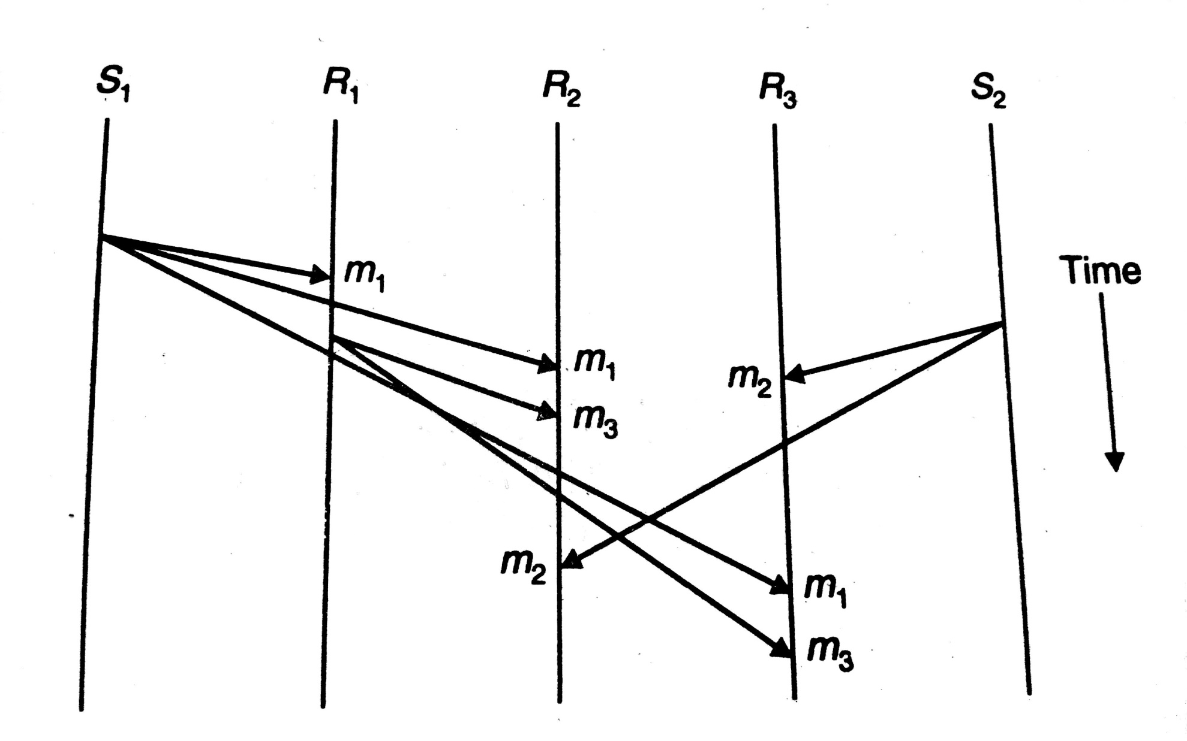
CAUSAL ORDERING

Slide 74
Thank You!!!!

